Slide 1
Hierarchical Coded Caching
Nikhil Karamchandani, Urs Niesen, Mohammad Ali Maddah-Ali, and Suhas Diggavi
IEEE Transactions on Information Theory(2016)

Slide 2
INTRODUCTION
PROBLEM SETTING
PRELIMINARIES
MAIN RESULTS
CACHING SCHEMES
PROOF OF THEOREM1
APPENDIX A : RATES FOR THE GENERALIZED CACHING SCHEME
APPENDIX B : LOWER BOUNDS
APPENDIX C AND D : GAP OF R1 AND GAP OF R2

Slide 3
1. INTRODUCTION
Coded Caching : It is shown there that the reduction in rate due to these coded multicasting opportunities is significant and can be on the order of the number of users in the network
In practice, many caching systems consist of not only one but multiple layers of caches, usually arranged in a tree-like hierarchy with the origin server at the root node and the users connected to the leaf caches。
Motivated by practical scenarios, we consider in this work a hierarchical content delivery network with two layers of caches
Main idea : combines two basic approaches
The first approach provides coded multicasting opportunities within each layer
The second approach provides coded multicasting opportunities across multiple layers

Slide 4
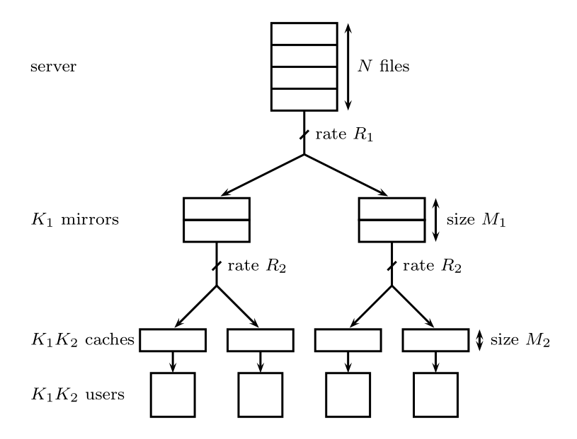
1. INTRODUCTION
There is no tension between R1 and R2.Thus, both layers can simultaneously operate at approximately minimum rate.
The proposed caching scheme attains the approximately optimal memory-rate tradeoff to within a constant additive and multiplicative gap

Slide 5
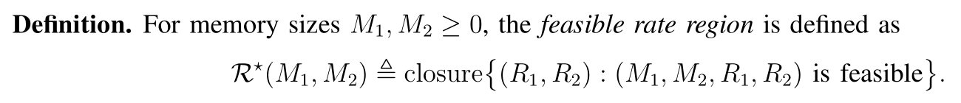

2. PROBLEM SETTING
N个文件，K1个mirror，每个mirror有K2个用户，总共有K1K2个用户。本文只考虑N>K1K2。
User(i,j)表示mirror i所连接的第j个用户。1≤i≤K1， 1≤j≤K2
Matrix D with entry $d_{i.j}∈\{1,2,…,N$} 表示所有用户请求的文件（满足所有用户的任意请求）

Slide 6
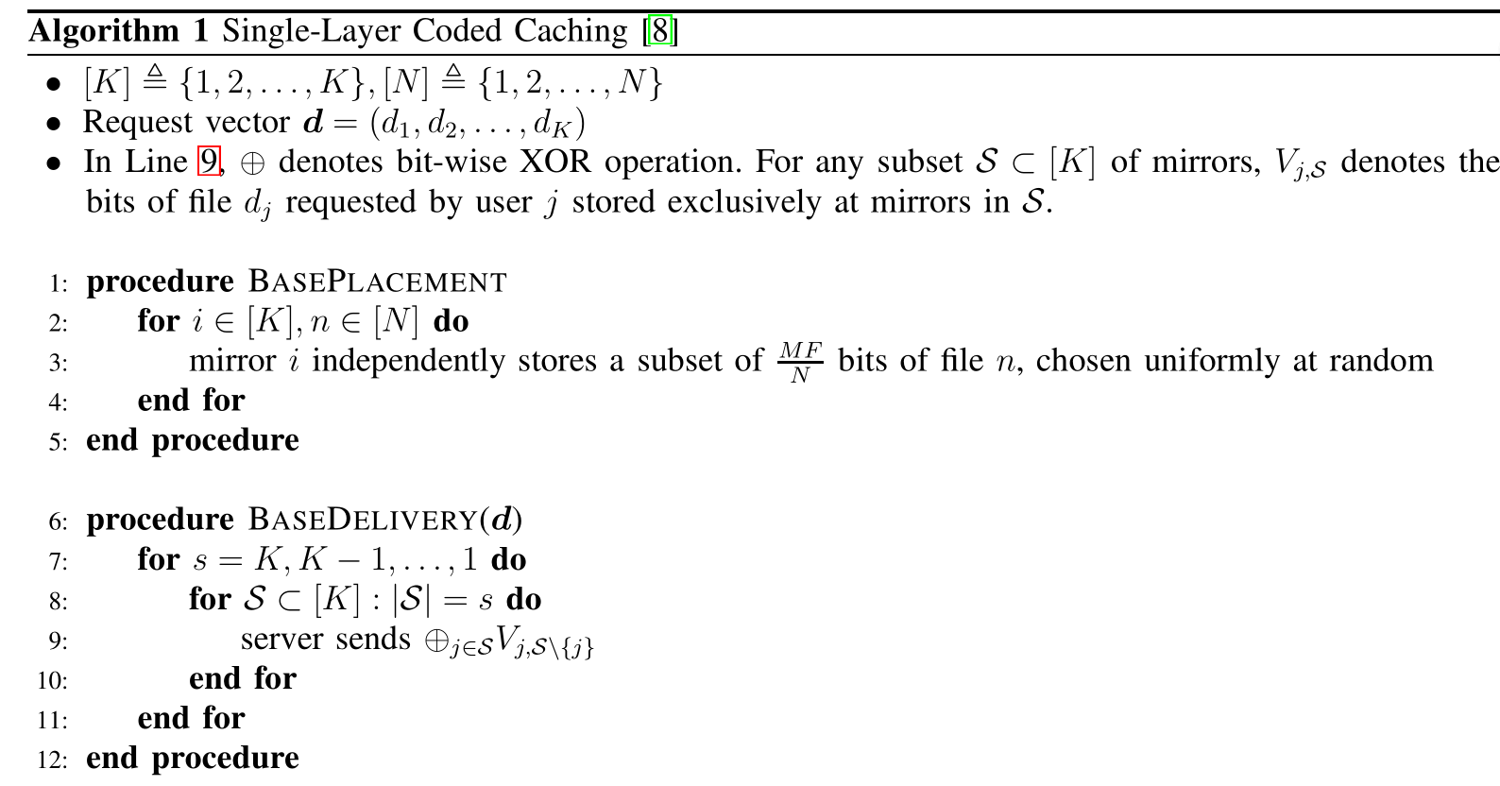
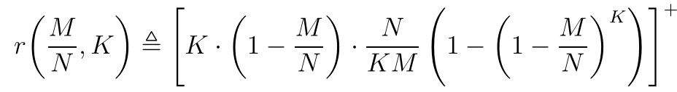

3. PRELIMINARIES
用decentralized scheme
考虑第一层$R_{1}$，当N＞K时
当考虑第二层$R_{2}$时
$R_{1}$=$K_{2}·r(\frac{M_{1}}{N},K_{1})$
乘以$K_{2}$是由于每个mirror有$K_{2}$个用户，每个mirror
要先得到$K_{2}个$文件，这里用了算法$K_{2}次$

Slide 7

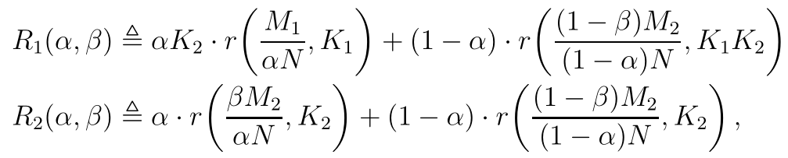
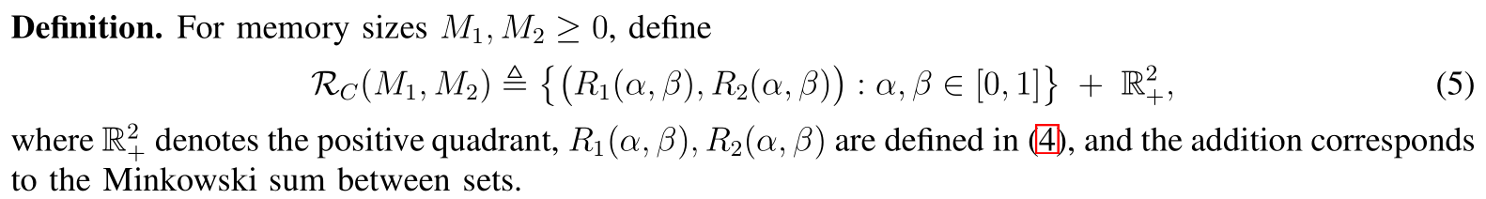
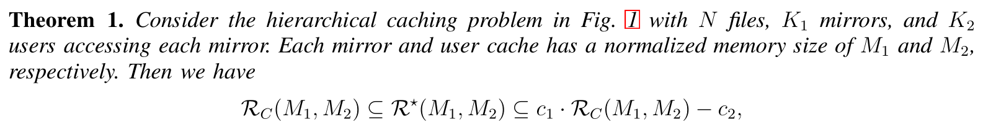
4. MAIN RESULTS
scheme1下的R
scheme2下的R
第一层的R
第二层的R
remark:The set is thus the rate region achieved by all possible choices of the parameters α and β
α和β规定了两种scheme的权重，其中α决定了所有文件关于两种scheme分配的比例，β规定了用户cache size关于两种scheme分配的比例。两种scheme是不相交的。

Slide 8
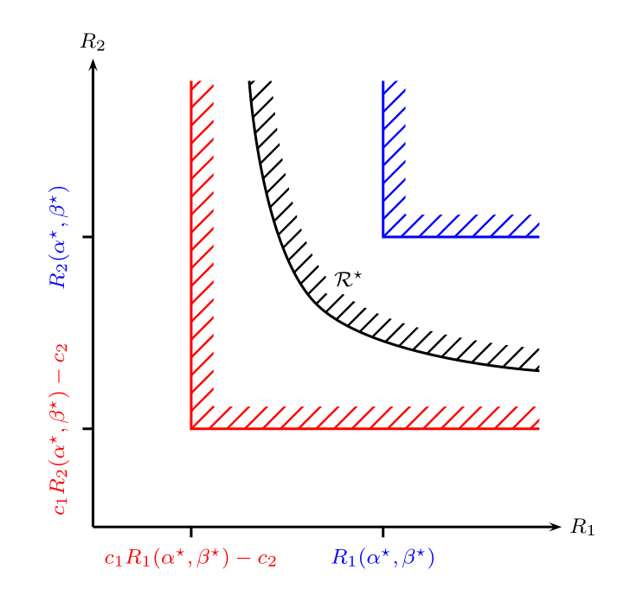
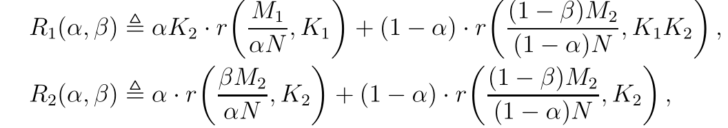

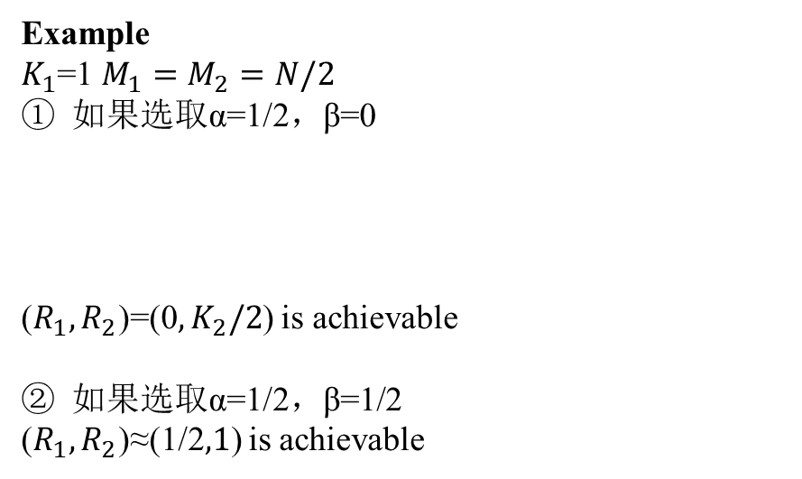
4. MAIN RESULTS
Example
$K_{1}$=1 $M_{1}=M_{2}=N/2$
如果选取α=1/2，β=0
($R_{1},R_{2}$)=(0$,K_{2}/2$) is achievable
如果选取α=1/2，β=1/2
($R_{1},R_{2}$)≈(1/2$,1$) is achievable
$α^{∗}$和$β^{∗}$是作者选取的比较合适的值

Slide 9
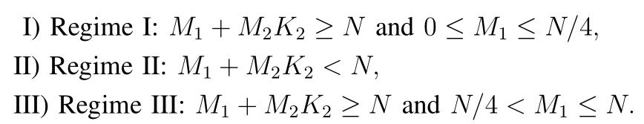
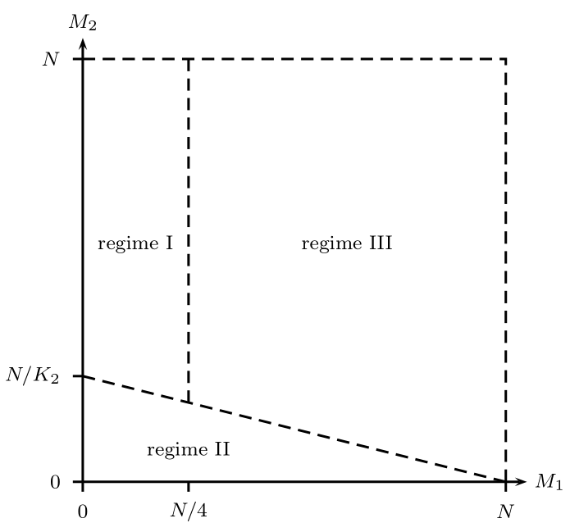
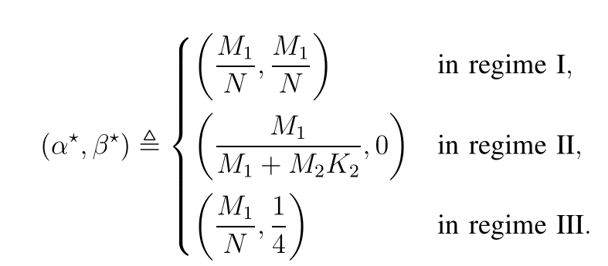
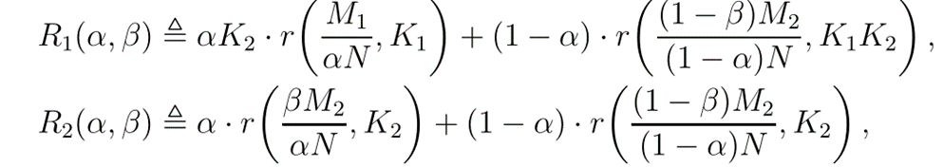
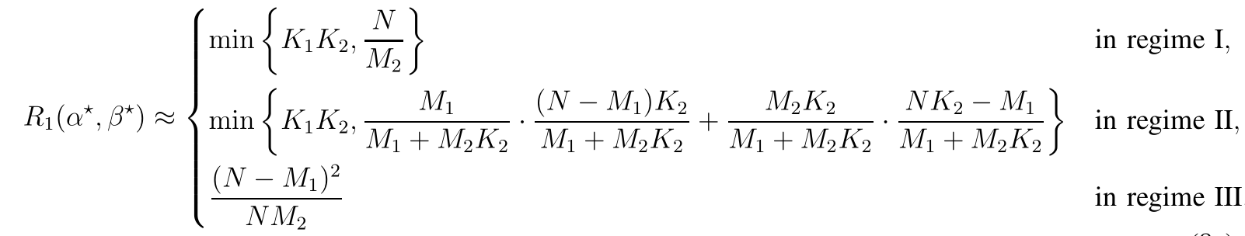

4. MAIN RESULTS(choosing $α^{∗} and{ β}^{∗}$)

Slide 10
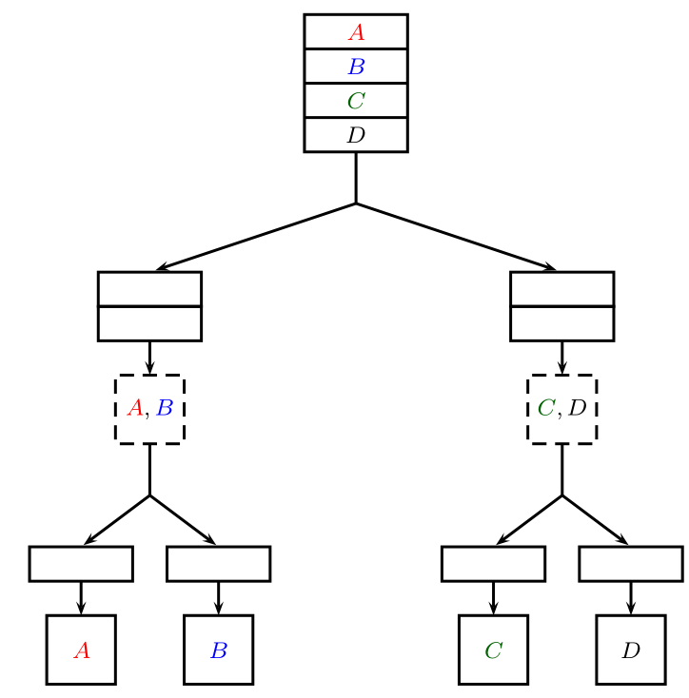
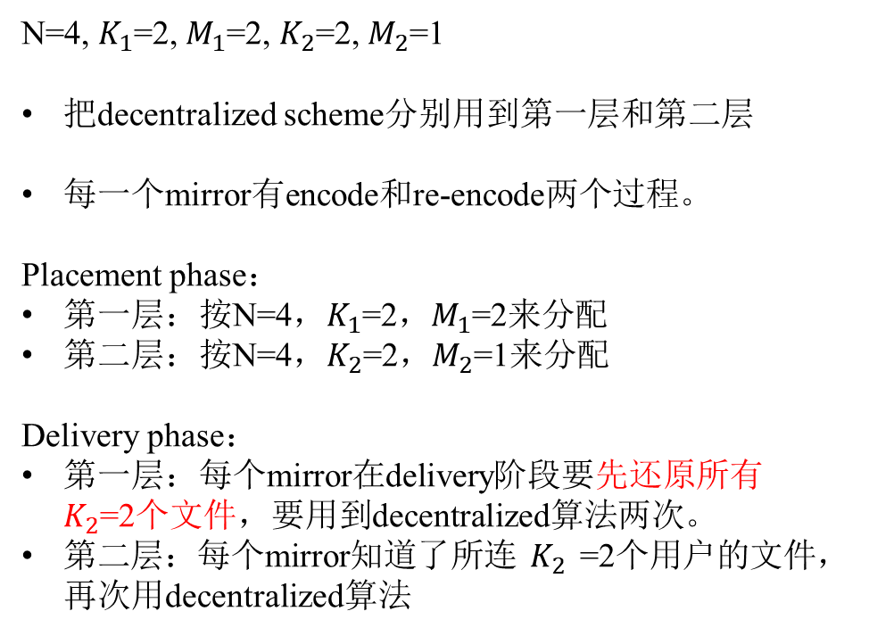
5. CACHING SCHEMES(Caching Scheme A)
N=4, $K_{1}$=2, $M_{1}$=2, $K_{2}$=2, $M_{2}$=1
把decentralized scheme分别用到第一层和第二层
每一个mirror有encode和re-encode两个过程。
Placement phase：
第一层：按N=4，$K_{1}$=2，$M_{1}$=2来分配
第二层：按N=4，$K_{2}$=2，$M_{2}$=1来分配
Delivery phase：
第一层：每个mirror在delivery阶段要先还原所有$K_{2}$=2个文件，要用到decentralized算法两次。
第二层：每个mirror知道了所连$K_{2}$=2个用户的文件，再次用decentralized算法

Slide 11
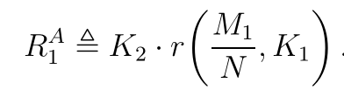
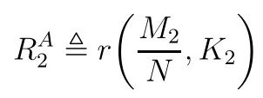


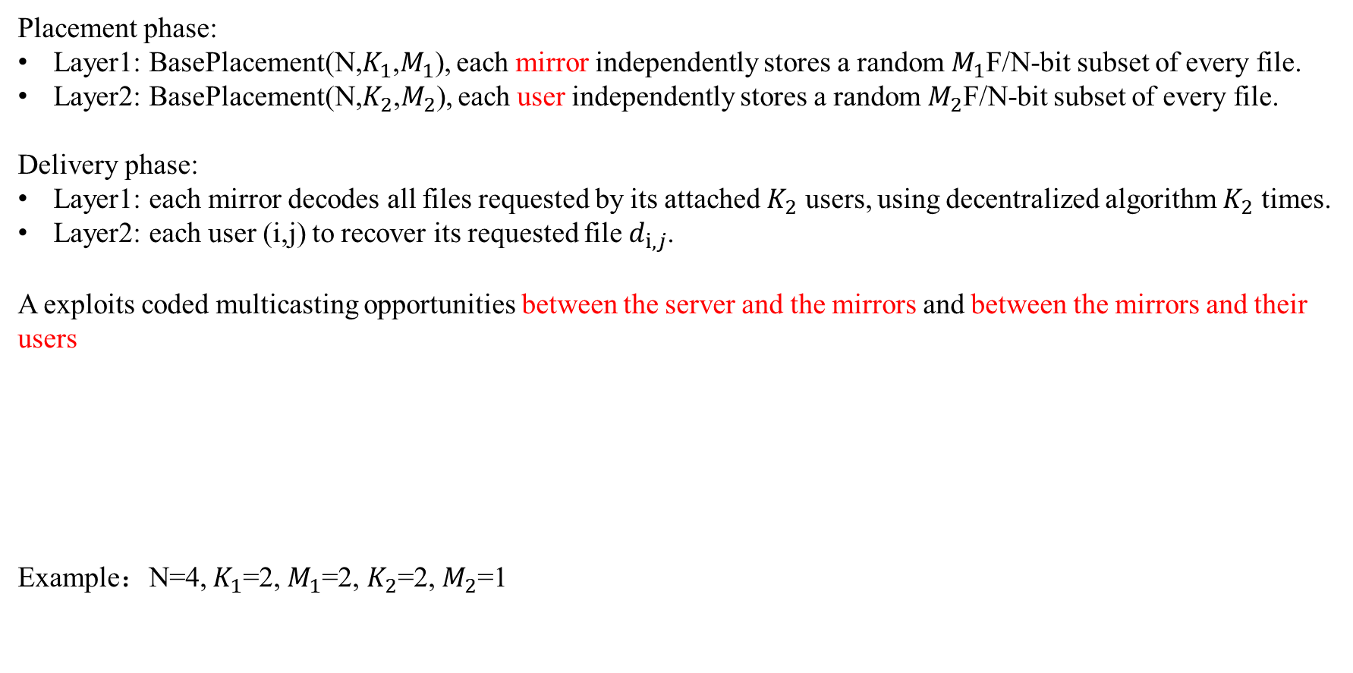
5. CACHING SCHEMES(Caching Scheme A with formal description)
Placement phase:
Layer1: BasePlacement(N,$K_{1}$,$M_{1}$), each mirror independently stores a random $M_{1}$F/N-bit subset of every file.
Layer2: BasePlacement(N,$K_{2}$,$M_{2}$), each user independently stores a random $M_{2}$F/N-bit subset of every file.
Delivery phase:
Layer1: each mirror decodes all files requested by its attached $K_{2}$ users, using decentralized algorithm $K_{2}$ times.
Layer2: each user (i,j) to recover its requested file $d_{i,j}$.
A exploits coded multicasting opportunities between the server and the mirrors and between the mirrors and their users
Example：N=4, $K_{1}$=2, $M_{1}$=2, $K_{2}$=2, $M_{2}$=1

Slide 12
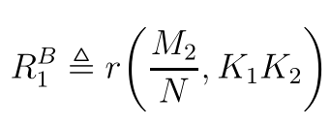
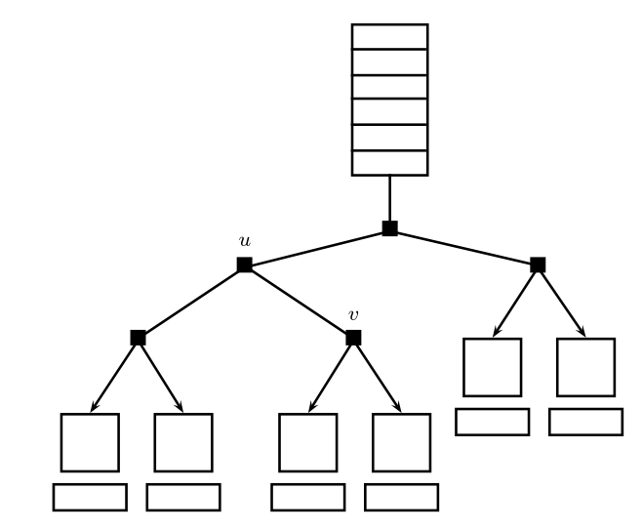
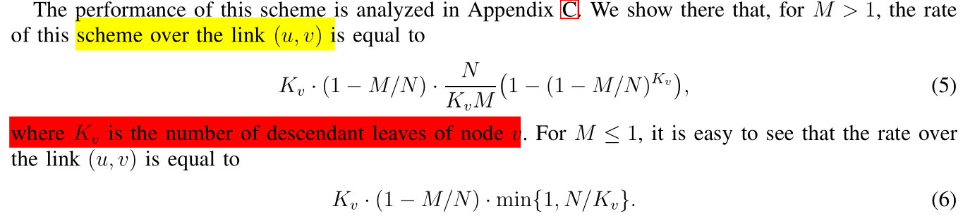

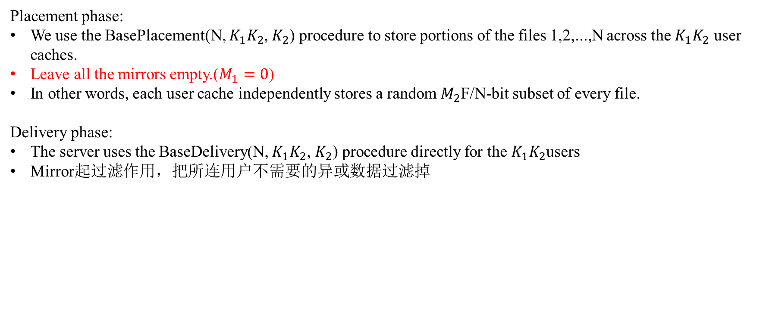
5. CACHING SCHEMES(Caching Scheme B with formal description)
Placement phase:
We use the BasePlacement(N, $K_{1}K_{2}$, $K_{2}$) procedure to store portions of the files 1,2,...,N across the $K_{1}K_{2}$ user caches.
Leave all the mirrors empty.($M_{1}=0$)
In other words, each user cache independently stores a random $M_{2}$F/N-bit subset of every file.
Delivery phase:
The server uses the BaseDelivery(N, $K_{1}K_{2}$, $K_{2}$) procedure directly for the $K_{1}K_{2}$users
Mirror起过滤作用，把所连用户不需要的异或数据过滤掉

Slide 13
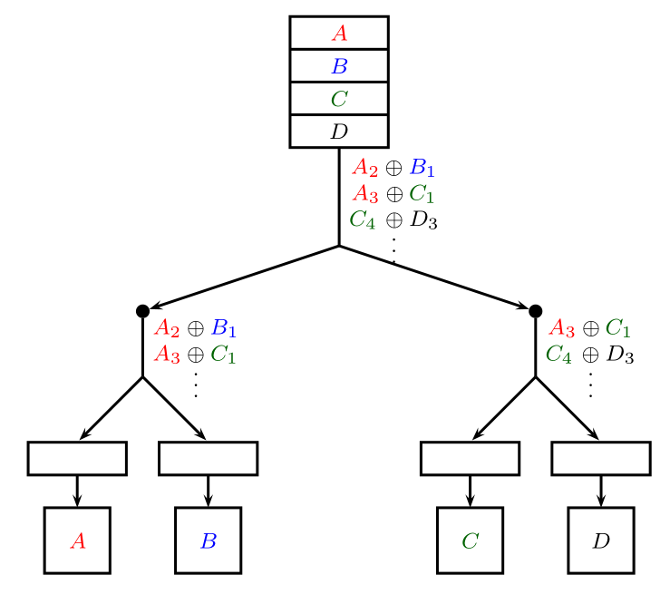
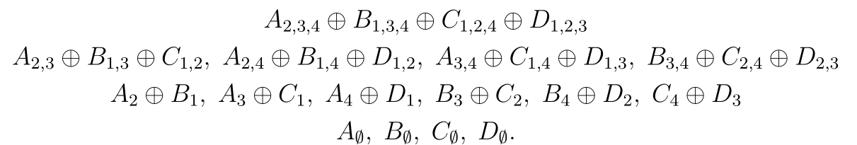
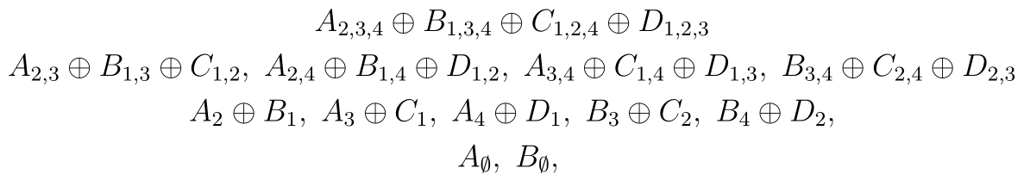



5. CACHING SCHEMES(Caching Scheme B)
N=4, $K_{1}$=2, $K_{2}$=2, $M_{2}$=1
第一层：
第二层（考虑mirror1，过滤后）

Slide 14
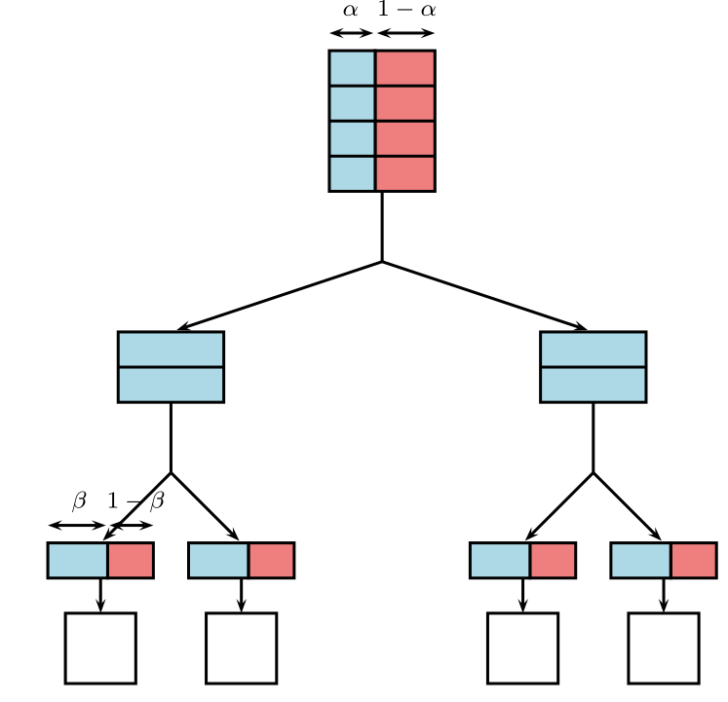
5. CACHING SCHEMES(Generalized Caching Scheme)
The generalized caching scheme divides the system into two subsystems, the first one operated according to caching scheme A and the second one according to caching scheme B
α和β规定了两种scheme的权重，其中α决定了所有文件关于两种scheme分配的比例，β规定了用户cache size关于两种scheme分配的比例。两种scheme是不相交的。
The first subsystem includes the entire memory of each mirror and a β fraction of each user cache memory.
The second subsystem includes the remaining (1−β) fraction of each user cache memory
We split each file into two parts of size αF and (1 − α)F bits.
The first part of all files belongs to first subsystem(scheme A)
The second part of all files belongs to second subsystem(scheme B)
Since our system is a composition of two disjoint subsystems, the net rate over each transmission link is the sum of the corresponding rates in the two subsystems

Slide 15
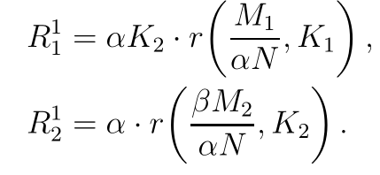
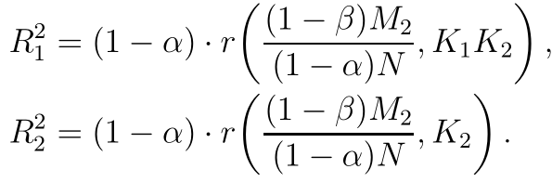
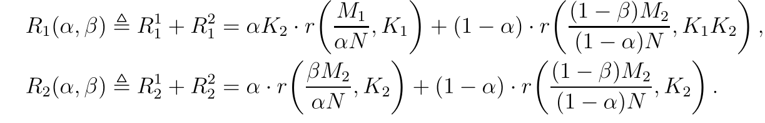
5. CACHING SCHEMES(Generalized Caching Scheme)
Scheme A:
第一层
第二层
Scheme B:
第一层
第二层
因为不相交，总的R是两种scheme下的R加起来的结果

Slide 16
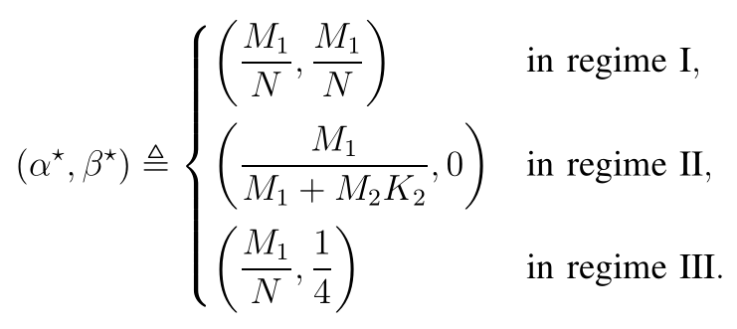
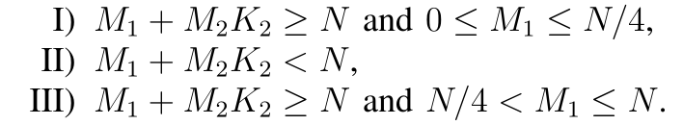
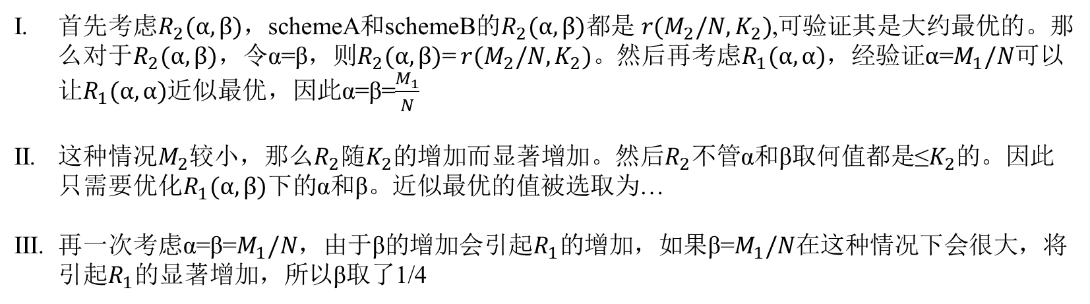
5. CACHING SCHEMES(Choice of $α^{∗} and{ β}^{∗}$)
首先考虑$R_{2}(α,β)$，schemeA和schemeB的$R_{2}(α,β)$都是$r(M_{2}/N,K_{2})$,可验证其是大约最优的。那么对于$R_{2}(α,β)$，令α=β，则$R_{2}(α,β)$= $r(M_{2}/N,K_{2})。$然后再考虑$R_{1}(α,α)$，经验证$α$=$M_{1}/N$可以让$R_{1}(α,α)$近似最优，因此α=β=$\frac{M_{1}}{N}$
这种$情况M_{2}$较小，那么$R_{2}$随$K_{2}$的增加而显著增加。然后$R_{2}$不管α和β取何值都是≤$K_{2}$的。因此只需要优化$R_{1}(α,β)$下的α和β。近似最优的值被选取为…
再一次考虑α=β=$M_{1}/N$，由于β的增加会引起$R_{1}$的增加，如果β=$M_{1}/N$在这种情况下会很大，将引起$R_{1}$的显著增加，所以β取了1/4

Slide 17
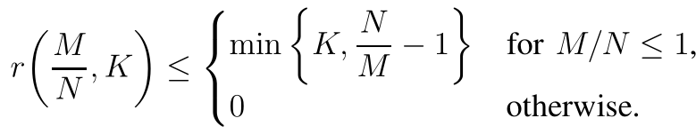
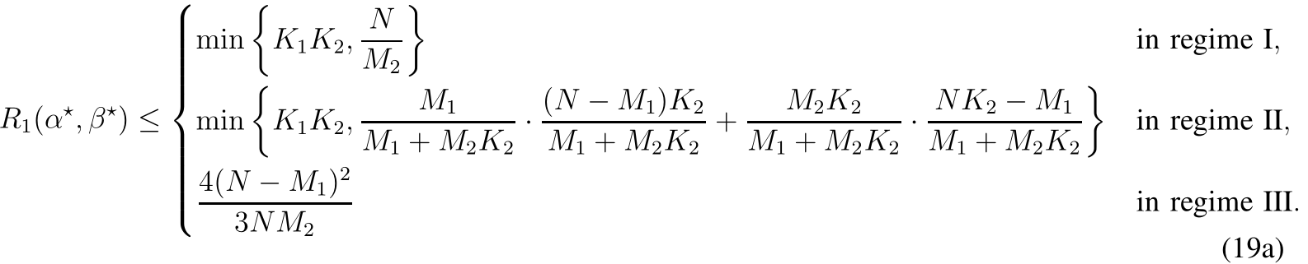
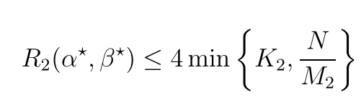
5. CACHING SCHEMES(Achievable rates $R_{1}\left(α^{∗},{ β}^{∗}\right),{ R}_{2}(α^{∗},{ β}^{∗})$)
对achievable rate再求上界用于方便算gap

Slide 18

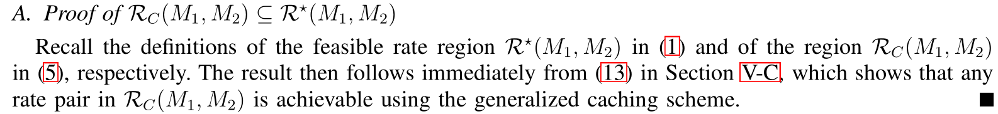
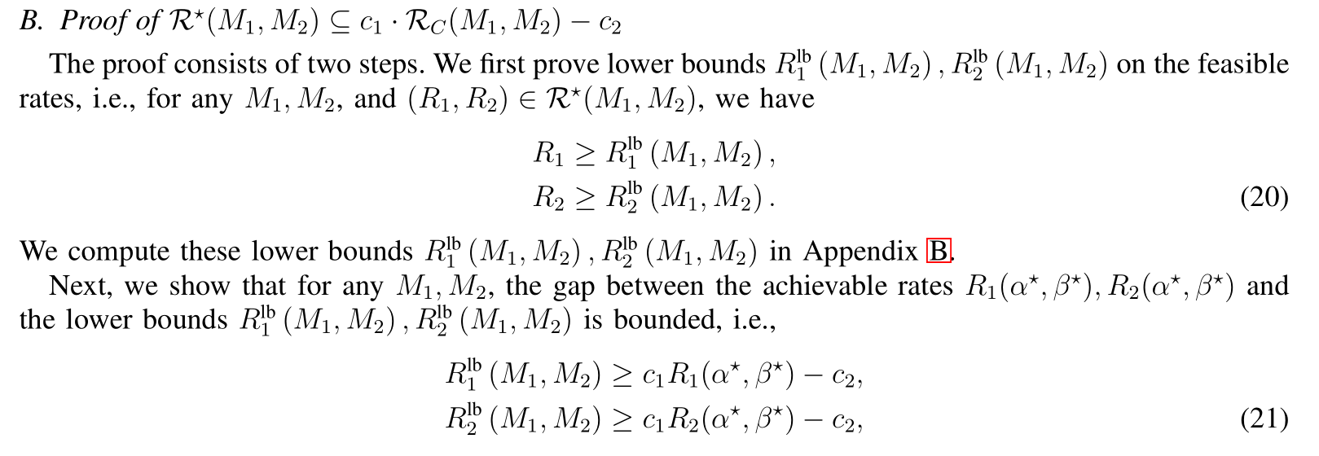
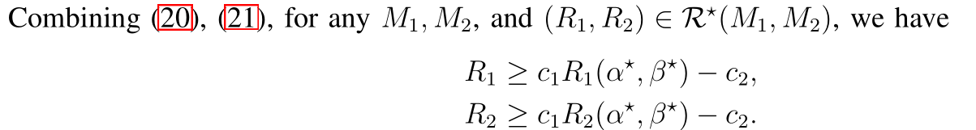
6. PROOF OF THEOREM1

Slide 19
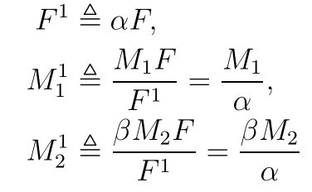
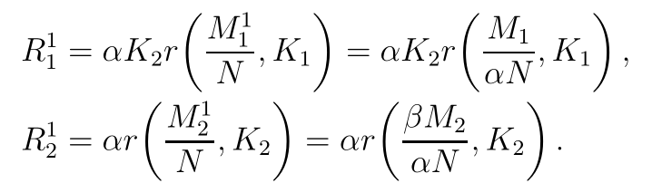
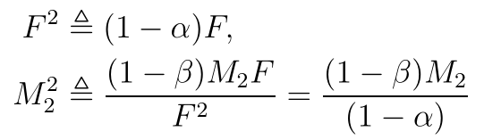
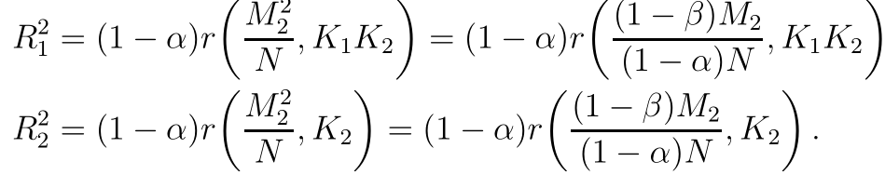
7. APPENDIX A : RATES FOR THE GENERALIZED CACHING SCHEME
Subsystem1
拥有每个文件的α部分，每个mirror拥有所有的cache size，每个用户拥有β部分的cache size
Subsystem2
拥有每个文件的1-α部分，不考虑mirror，每个用户拥有1-β部分的cache size
综上

Slide 20
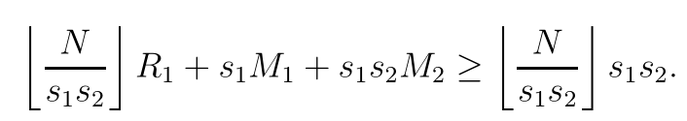
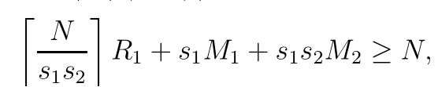
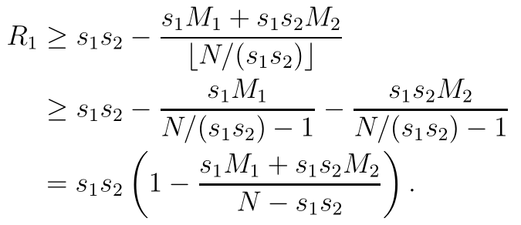
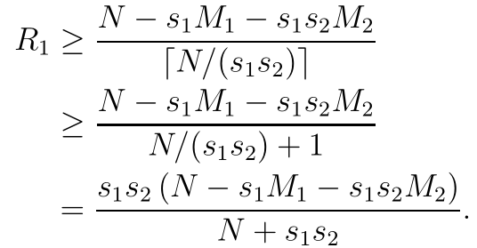


8. APPENDIX B : LOWER BOUNDS($R_{1}$)
与fundamental limits of caching 中下界的证明类似
固定$s_{1}∈\left\{1,2,…,K_{1}\right\},s_{2}∈\{1,2,…,K_{2}\}$,即考虑$s_{1}s_{2}$个用户
综上，考虑所有的$s_{1},s_{2}$

Slide 21


8. APPENDIX B : LOWER BOUNDS($R_{2}$)
$R_{2}$没有考虑mirror，可以看成是单层的结构，直接用cut-set bound
固定t∈{1,2,…, $K_{2}$}个用户，有
综上，考虑所有的t

